Slide 1
Topic 2. Exploring Data

Slide 2
What Is Data?
Collection of data objects and their attributes
Object is also known as record, point, case, sample, entity, or instance
An attribute is a property or characteristic of an object
Examples: age, height, weight, education of a person
Attribute is also known as variable, field, characteristic or feature
A collection of attributes that describe an object

Slide 3
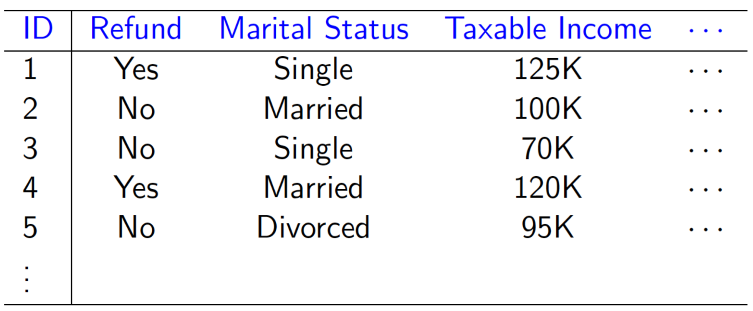
A Toy Model

Slide 4
Types of Variables
Continuous variable
Example: length, time, count, weight, height
Nominal (categorical) variable
Example: race, sex, marital status, eye color
Ordinal variable
Example: age group (children, youth, adults, seniors), letter grade, satisfaction rating (“dislike”, “neutral”, “like”)
Interval variable
Example: temperature, salary range

Slide 5
Types of Data
Data matrix
Text data, image data, audio data, video data
Transactions data
Graph data

Slide 6
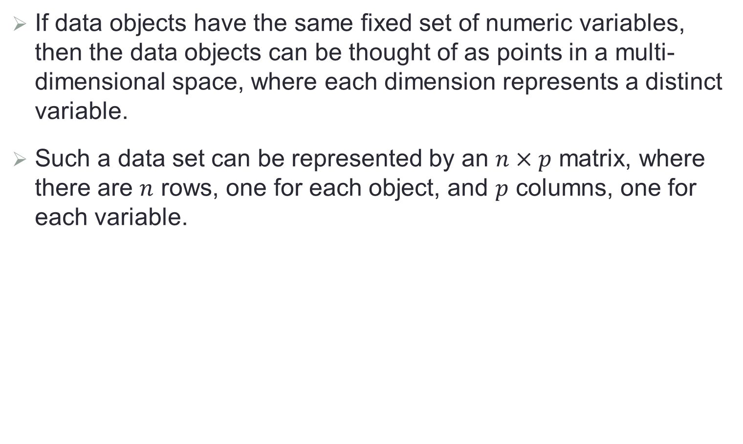
Data Matrix
If data objects have the same fixed set of numeric variables, then the data objects can be thought of as points in a multi-dimensional space, where each dimension represents a distinct variable.
Such a data set can be represented by an $n×p$ matrix, where there are $n$ rows, one for each object, and $p$ columns, one for each variable.
Patient index | Sex | Age | Smoker (Y/N) | Alcohol (Y/N)
1 | F | 28 | N | Y
2 | M | 35 | N | N
3 | M | 60 | Y | Y

Slide 7
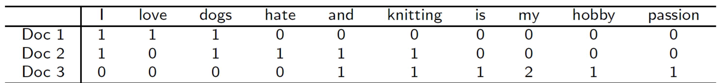
Text Data
Each textual document becomes a vector of terms
Each term corresponds to a word or phrase
The element of the vector is the number of times the corresponding term appears in the textual document.
Example:
Doc 1: I love dogs.
Doc 2: I hate dogs and knitting.
Doc 3: Knitting is my hobby and passion.
1

Slide 8
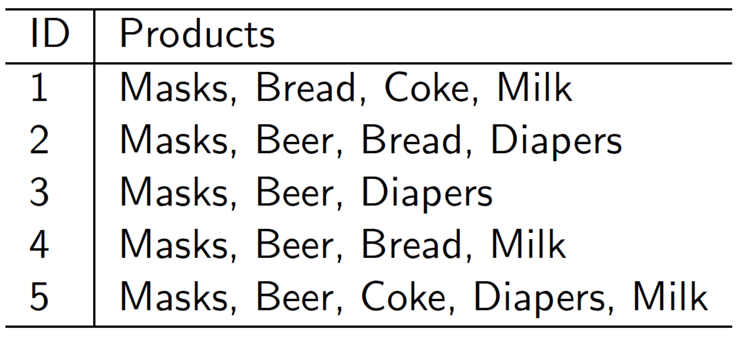
Transaction Data
A special type of record data
Each record (transaction) involves a set of items
Example: In a grocery store, the set of products purchased by a customer during one shopping trip constitute a transaction

Slide 9

Graph Data
Social network
Molecular structures

Slide 10
Data Quality
Quality of data is a very important factor for success of subsequent analysis.
Possible data quality issues
Noise and outliers
Missing values
Sampling bias

Slide 11
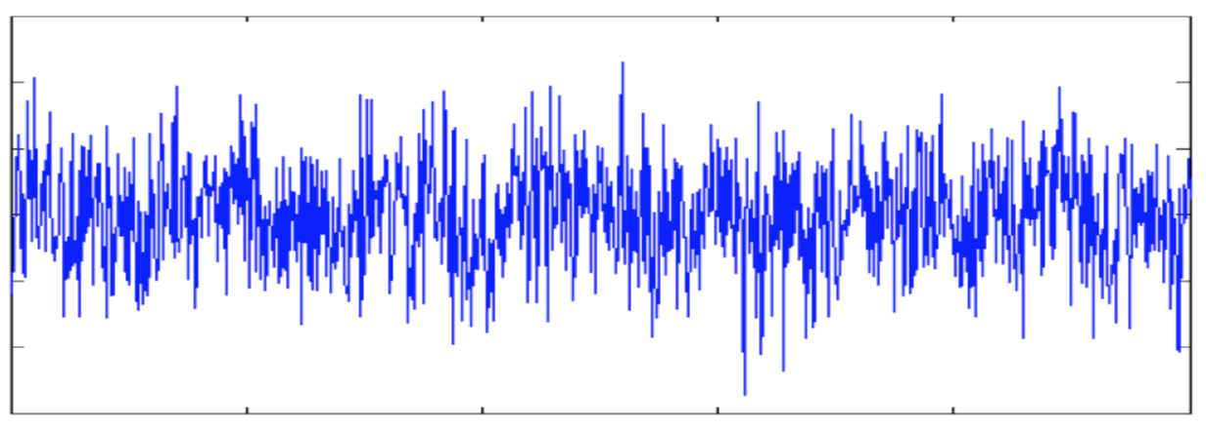
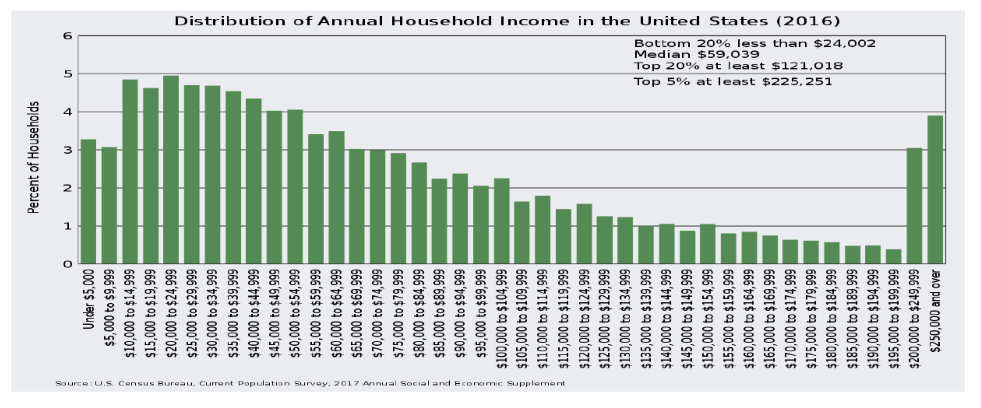
Noise and Outliers
Noise refers to perturbation of original values.
Outliers are observations that are considerably different from others.

Slide 12
Missing Values
Reasons for missing values
Information is not collected (e.g., people decline to give their age and weight)
Variables may not be applicable to all cases (e.g., annual income is not applicable to children)
Handling missing values
Eliminate all data objects with missing value
Impute missing values
Incorporate partial information of the missing values in data analysis

Slide 13
Sampling Bias
Sample distortion arises from a mismatch between the random sample and the population of interest.
Causes of sampling bias
Convenience sampling
Class imbalance (e.g., anomaly detection, disease prediction)
Avoiding and correcting sampling bias

Slide 14
What Is Data Exploration?
Preliminary exploration of the data to better understand its characteristics
Key motivations of data exploration include
Helping select the right tool for preprocessing or formal analysis
Making use of human’s abilities to recognize patterns
Exploratory data analysis (EDA)
Created by statistician John Turkey; see his seminal book on EDA

Slide 15
Data Exploration Techniques
In EDA, as originally defined by Tukey,
The focus was on visualization
Clustering and anomaly detection were viewed as exploratory techniques
In data mining, clustering and anomaly detection are major areas of interest
We will focus on
Summary statistics
Visualization

Slide 16
Summary Statistics
Summary statistics are numbers that summarize properties of the data.
Examples
Frequency: the percentage of time a given value appears in the data set
Mode: the value that appears most frequently
Location: mean, median, trimmed mean, percentile
Spread: range, variance, standard deviation
Skewness

Slide 17
Visualization
Visualization is the conversion of data into a visual format so that the characteristics of the data and the relationships among data objects or variables can be analyzed or reported.
Visualization of data is one of the most powerful and appealing techniques for data exploration.
Humans have a well developed ability to analyze large amounts of information that is presented visually.
It can detect general patterns and trends.
It can detect outliers and unusual patterns.

Slide 18
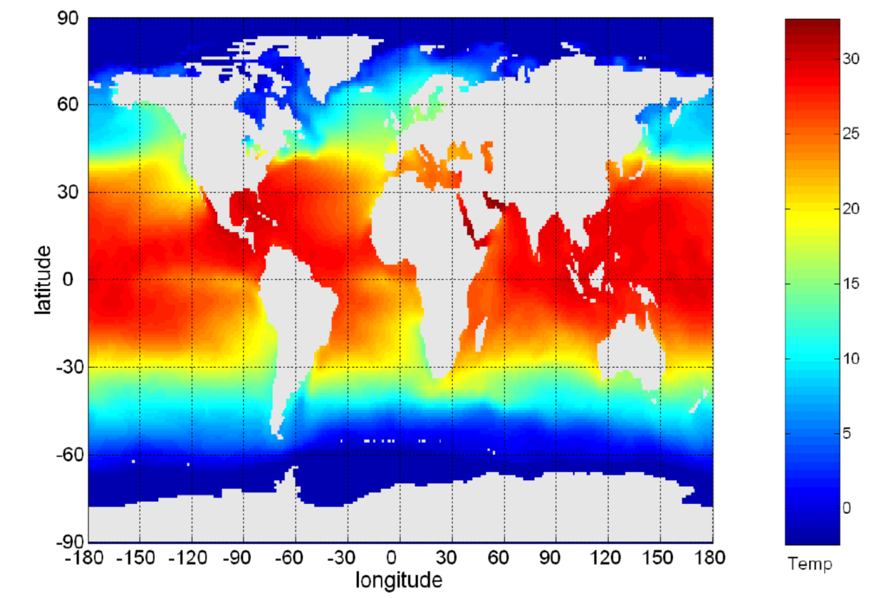
Sea Surface Temperature
Sea surface temperature for July 1982
Tens of thousands of data points are summarized in one single figure

Slide 19
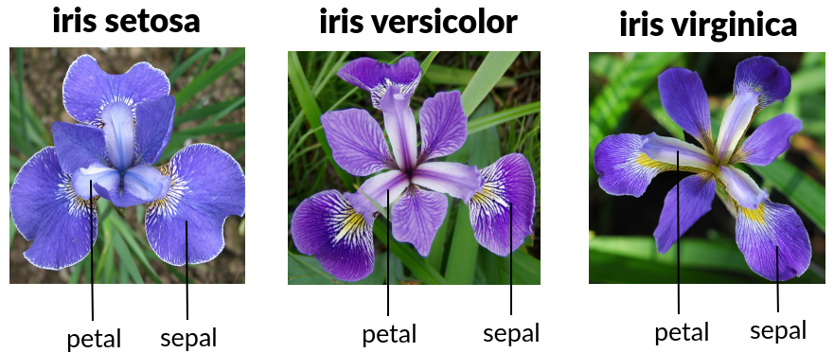
Iris Data
A classical dataset
Three iris types (classes): Setosa, Versicolor, Virginica
Four explanatory variables
Sepal width and length
Petal width and length
Sample size: 50 samples for each type

Slide 20
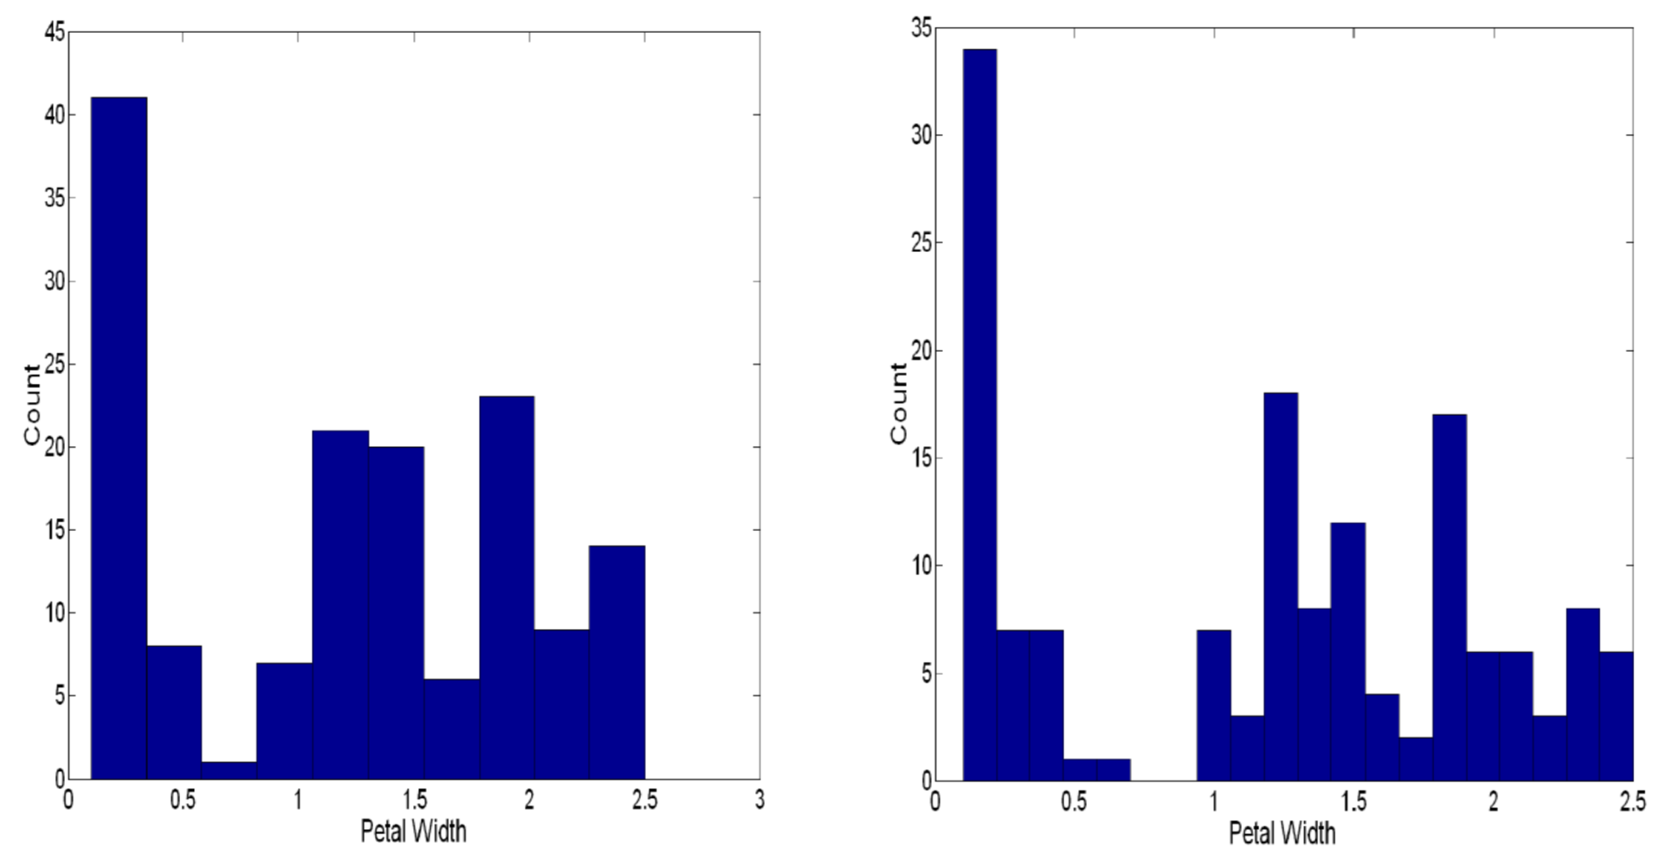
Histogram

Slide 21
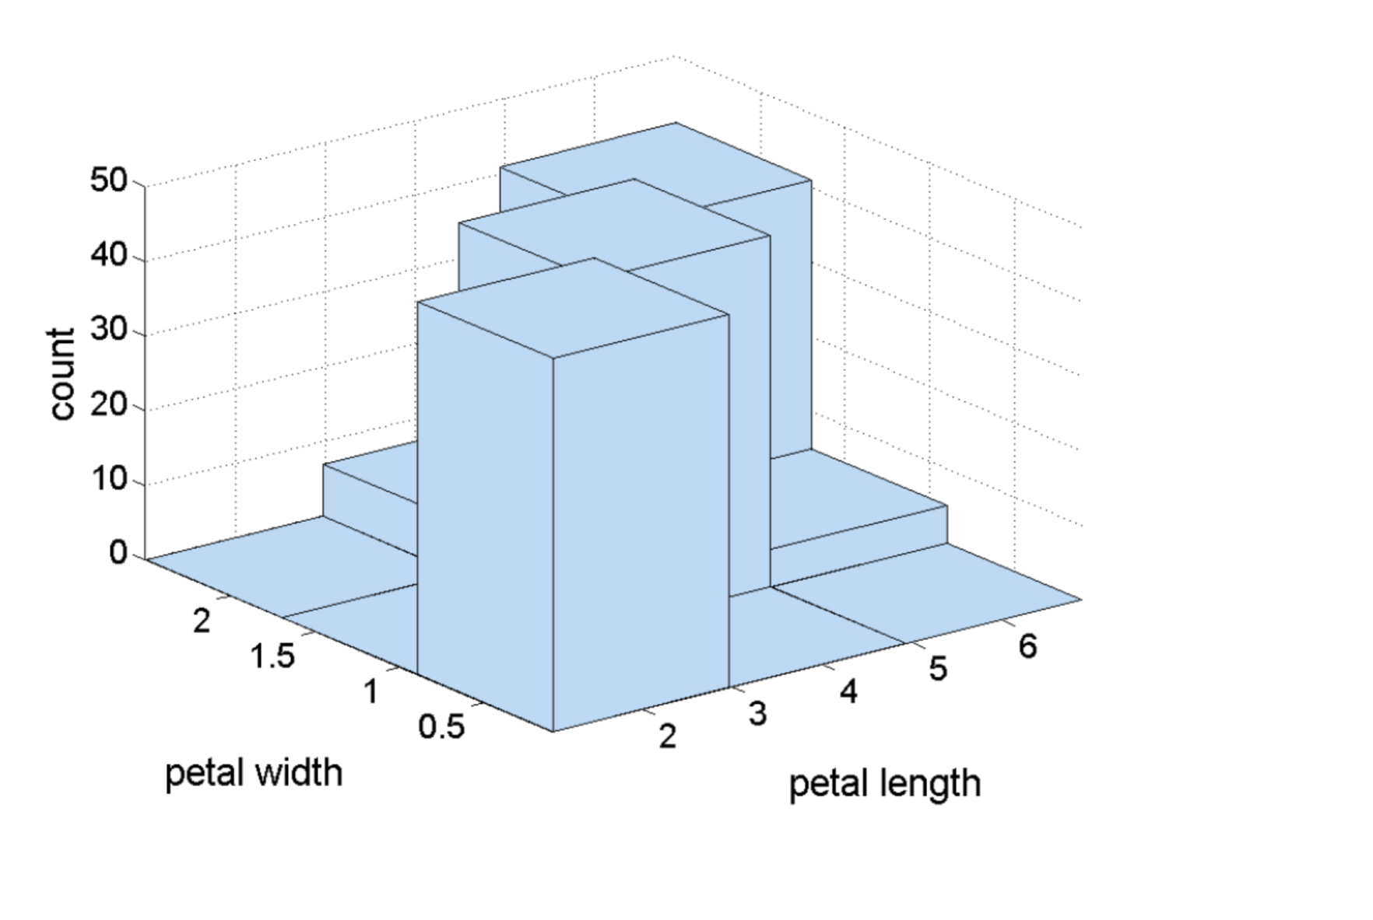
2D Histogram

Slide 22
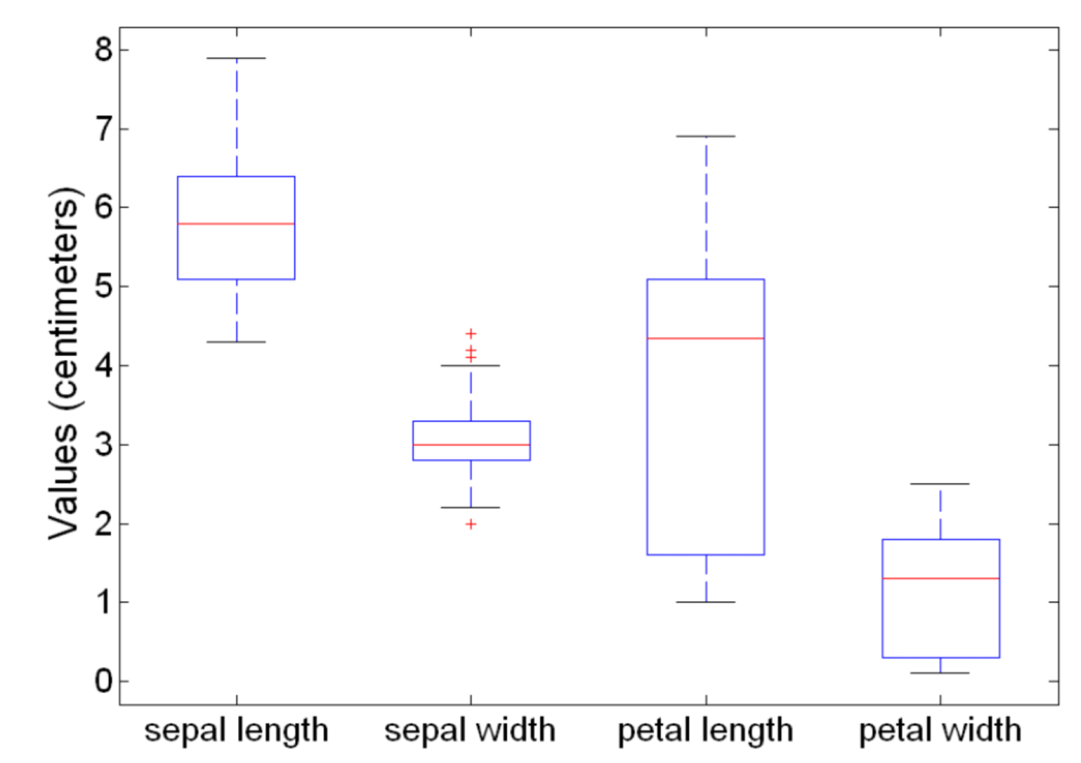
Boxplot

Slide 23
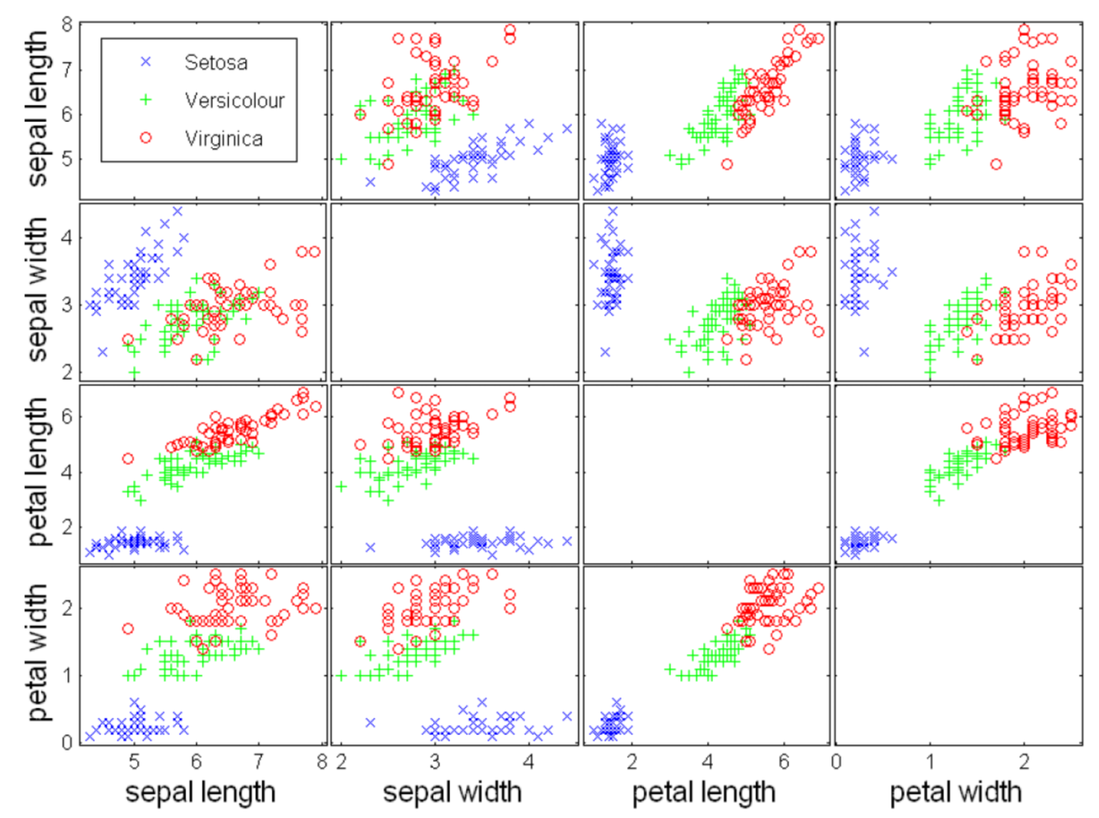
Scatter Plot

Slide 24
Matrix Plot
Plot the data matrix
This can be useful when objects are sorted according to class.
Typically, the variables are normalized to prevent one variable from dominating the plot.
Plots of similarity or distance matrices can also be useful for visualizing the relationships between objects.

Slide 25
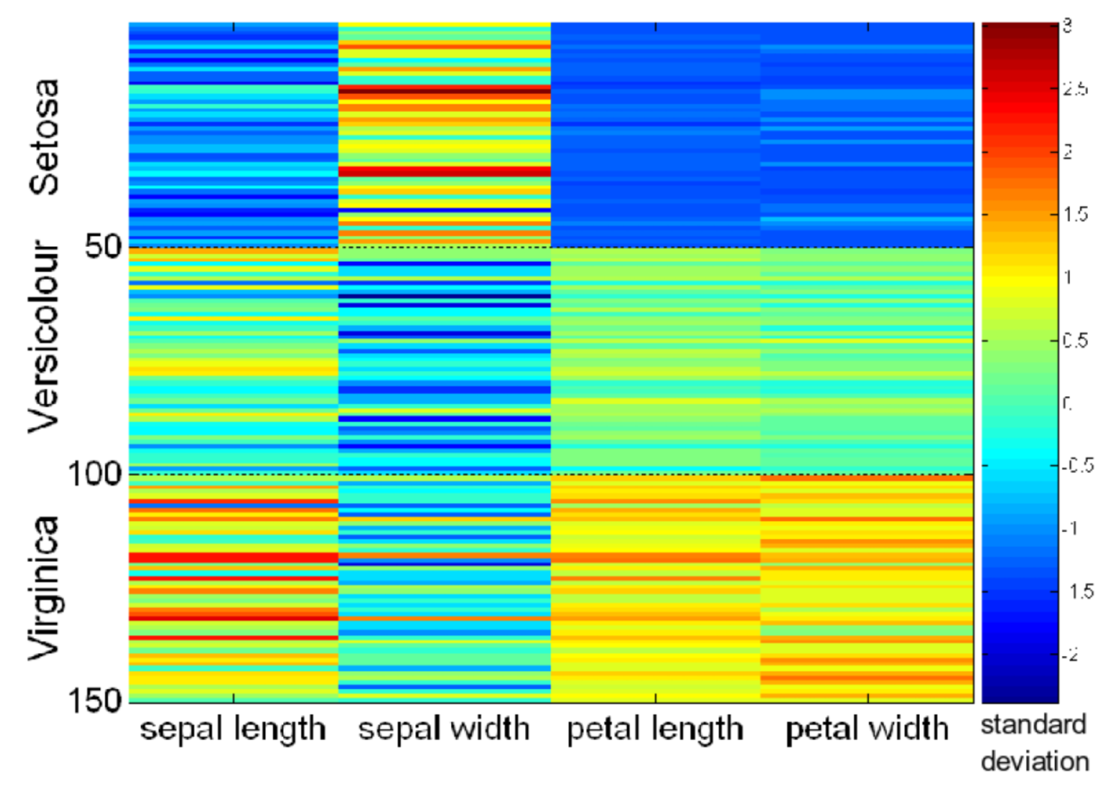
Iris Matrix Plot

Slide 26
Iris Similarity Matrix

Slide 27
Parallel Coordinates Plot
Use a set of parallel axes
The variable values of each object are plotted as a point on each corresponding coordinate axis and the points are connected by a line.
Thus, each object is represented by a line.
Often, the lines representing a distinct class of objects group together, at least for some variables.
Ordering of variables can be important.

Slide 28
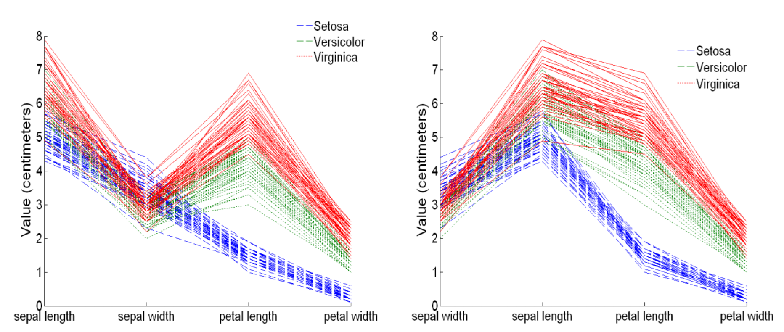
Example

Slide 29
Other Visualization Techniques
Star plots
Axes radiate from a central point
Each object becomes a polygon
Chernoff faces
Associate each variable with a characteristic of a face
The values of each variable determine the appearance of the corresponding facial characteristic
Each object becomes a separate face

Slide 30
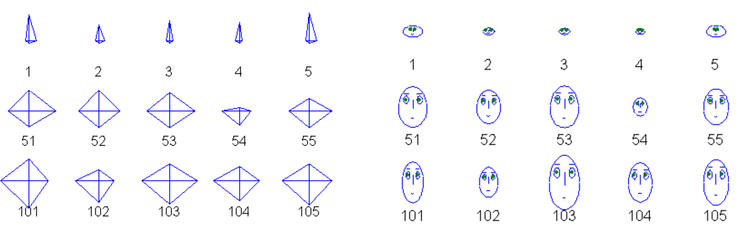
Example

